Slide 1
Wellness Chatbot
By Te Aroha team
Indira Bandari
Haripriya Vemparala
Govardhani Tammina
Shaifali Kanojia

Slide 2
What is the problem ?
In the current covid situation people with mental health concerns, living in remote areas, where the counseling help is miles away, may not get timely help.
Another scenario is some people may be facing stress and as a first step they would not want to visit a counsellor due to personal reasons.

Slide 3
What are we doing ?
We investigated counselchat.com website and analysed the question and answers in Power BI.
We predicted the upvotes using Azure Machine Learning

Slide 4
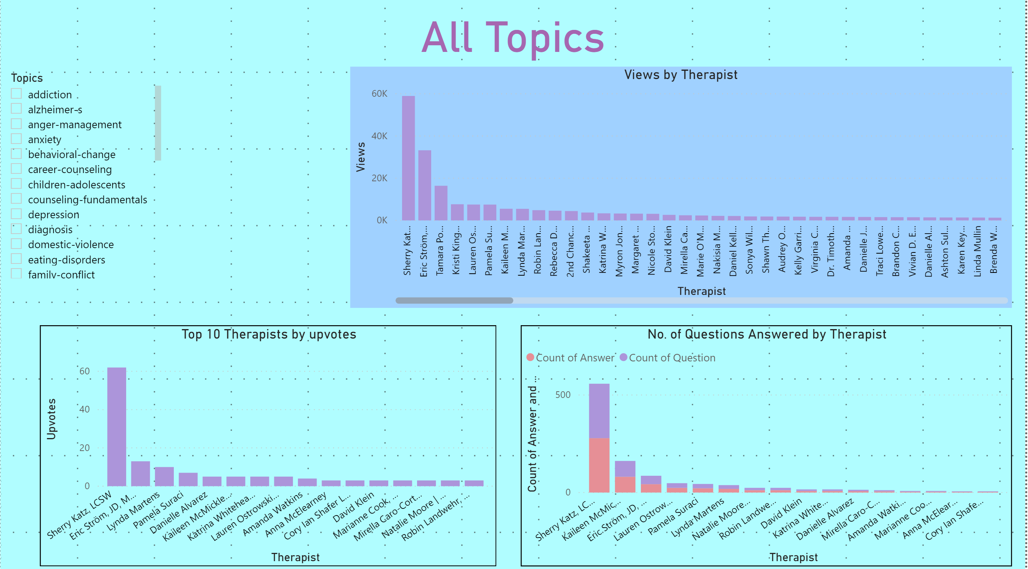
Investigation and Analysis

Slide 5
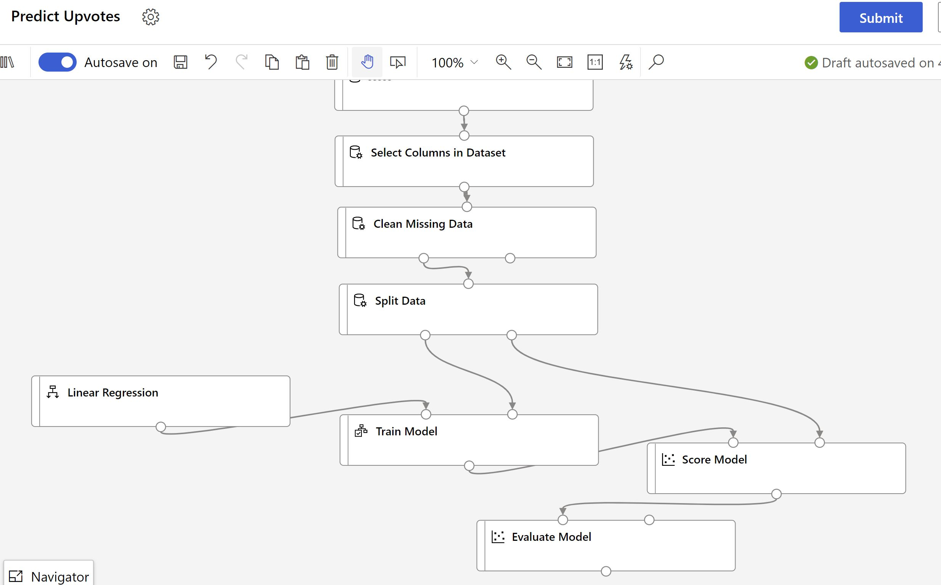
Upvotes Prediction

Slide 6
What is the solution ?
Based on the analysis and prediction, we were convinced that we can help people who are facing mental health issues by providing counseling help online. Therefore, we worked on the idea of building a wellness chatbot.
As a first step, only one topic was taken from counselchat which is depression
This chatbot can be integrated with health and therapy websites as a level 1 counseling support.

Slide 7
Who is going to benefit ?
People who are living in remote areas and need initial engagement with a counsellor.
People who may not be inclined to go to a therapist can use the chatbot as an initial option
The wellness support teams in the healthcare industry can integrate the chatbot with their websites and apps.

Slide 8
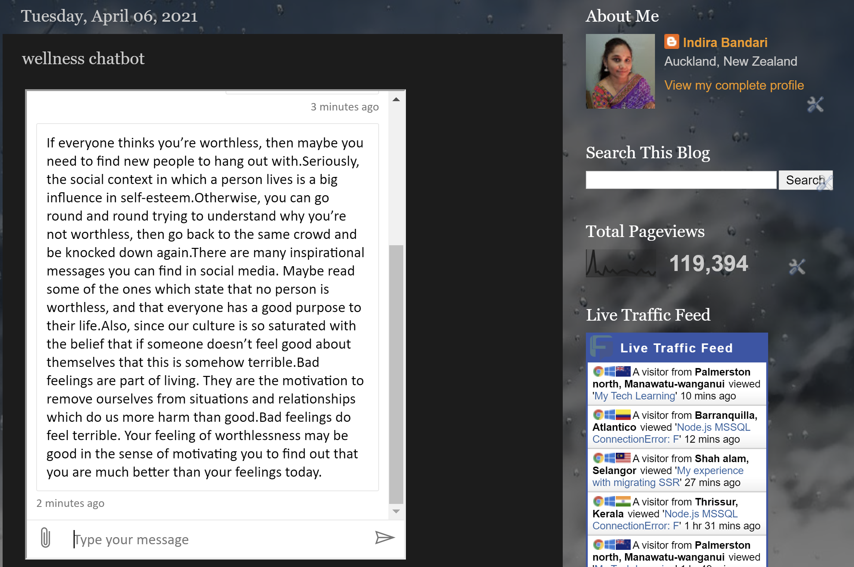
Wellness Chatbot

Slide 9
What approach did we take?
Scraped the data from www.counselchat.com using Power Query to get the question and answers into Power BI
Created data visualization by topic to analyse the no of questions and answers and upvotes
Used a csv file in Azure Machine Learning
Created a model to predict the upvotes using Azure Machine Learning
Used a few questions and answers from depression topic to create a chatbot with Azure QnA Maker and Bot Framework.
Created an integration/embed link for the chatbot to be embedded into various healthcare platforms.

Slide 10
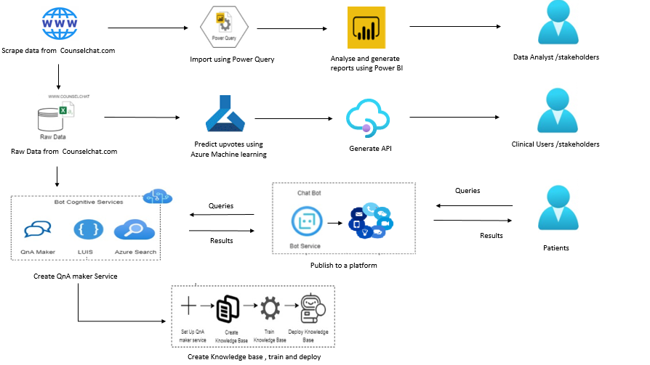
Solution Architecture

Slide 11
Link to the Solution
http://mytechlearning.blogspot.com/2021/04/wellness-chatbot.html
https://github.com/indupriya9/AIHackathon

Slide 12
Chatbot Embed Link
<iframe src='https://webchat.botframework.com/embed/counselchat?s=N_E8rfGBAdA.jIUBjNFbpOpfDX0Jgf0MyhaxCvrioSPzolJARFwnGYg' style='min-width: 400px; width: 100%; min-height: 500px;'></iframe>

Slide 13
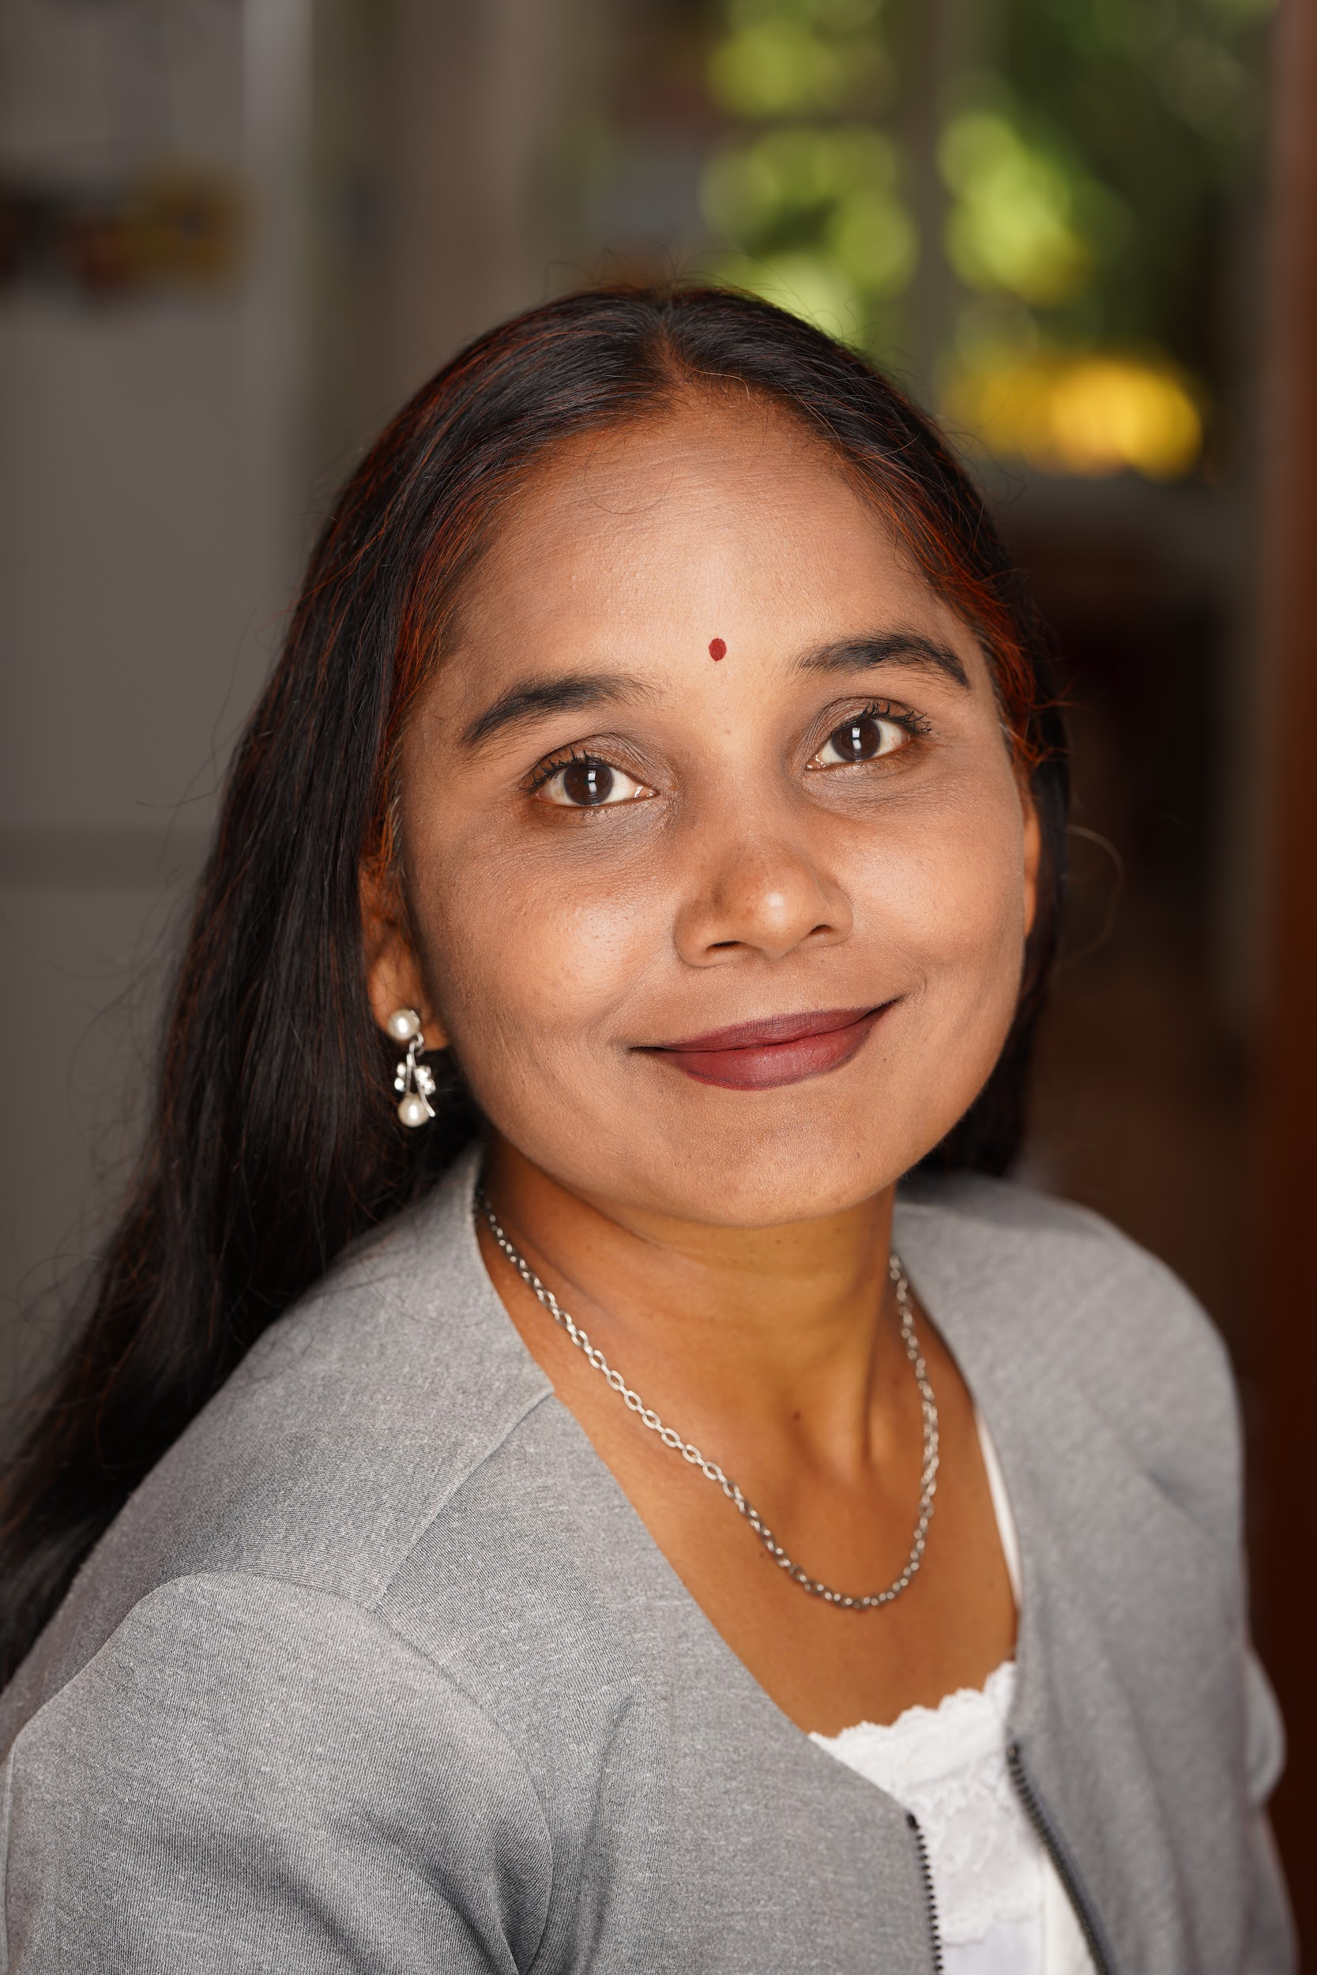
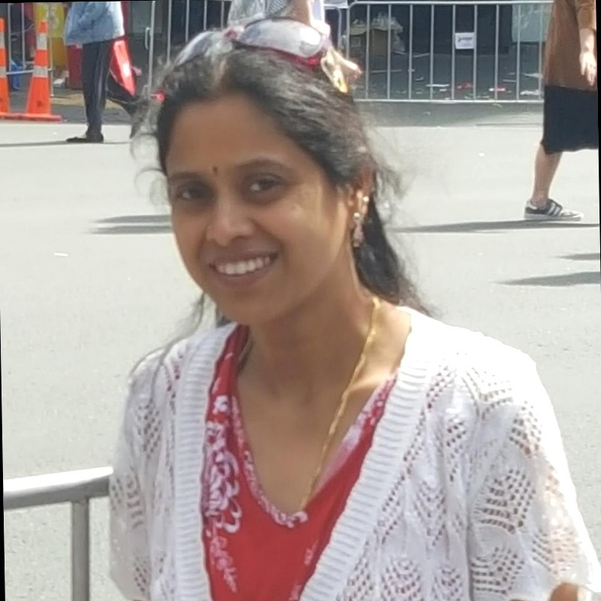

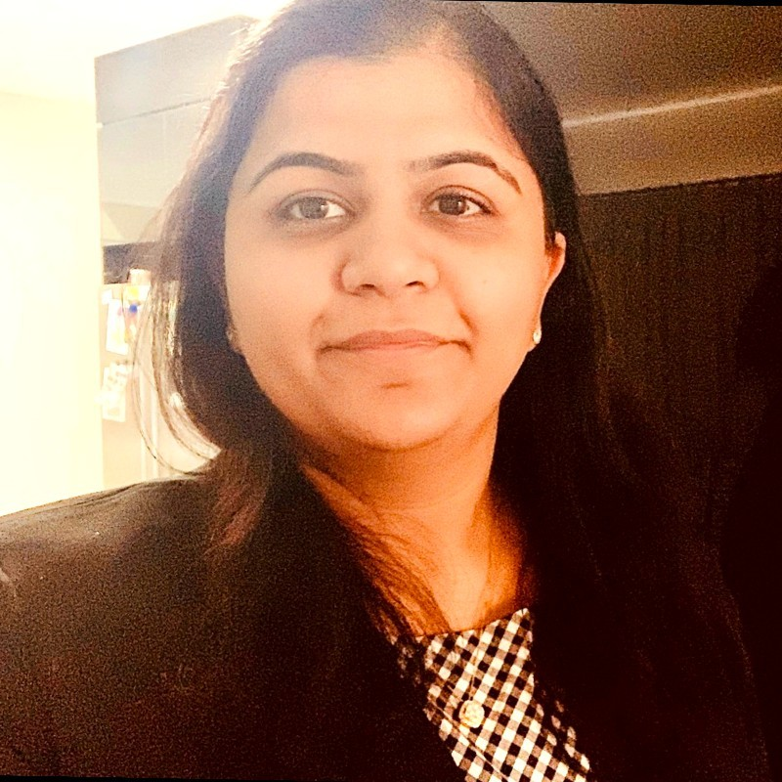
Team Te Aroha
Indira Bandari
BI and SQL Lead
Healthcare
Govardhani Tammina
Data Analyst
Education
Haripriya Vemparala
Implementation Lead and Data Analyst
Healthcare
Shaifali Kanojia
Data Services Analyst
Media

Slide 14
Thank You

